Slide 1
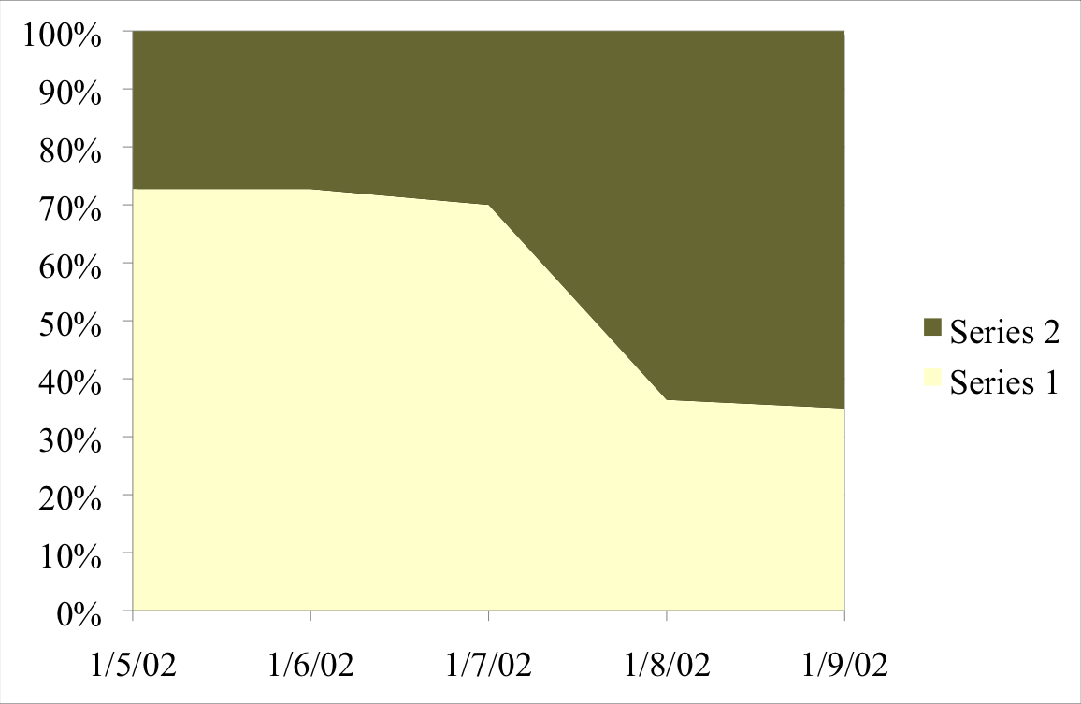
Title of Poster
Author and Email
SHINE Lab
High School Name, Class of 201X
USC Viterbi Department of ____ Engineering, SHINE 2017
Introduction
Skills Learned
How This Relates to Your STEM Coursework
Introduce the topic – this may mean giving an overview of the research being conducted by your professor and/or Ph.D. student mentor.
Talk about anything you’ve learned, done, grown to appreciate, or learned to see differently.
You may use pictures and figures
Here you will talk about the impact of your SHINE experience on understanding your STEM Coursework. You can also write about what you can bring back to your school to help them understand the significance of said STEM Coursework.
You may use pictures and figures
Objectives & Impact of Professor’s Research
As much as you can, read and summarize in your own words what your professor’s research is about and its impact in science or engineering and/or the environment, computing, traffic flow, baby’s brains, maximizing fuel efficiency in ships, etc.
Next Steps for You OR Advice for Future SHINE Students
If you have plans to or are interested in furthering your work done at SHINE mention it here. You can also choose to use this as a section to give any helpful advice for future SHINE students.
Figure one
Figure two
Acknowledgement
Always thank your professor, lab mentor(s), SURE mentor, perhaps your SHINE lab mate if you had one, and anyone involved in mentoring you (Dr. Katie Mills).
Caption for this chart
Caption for this chart

